Slide 1


SMART INDIA HACKATHON 2024
Problem Statement ID – SIH1700
Problem Statement Title- Developing an AI based interactive Chatbot or virtual assistant for the Department of Justice’s Website.
Theme - Smart Automation
PS Category- Software
Team ID - AI08
Team Name - AI Elites

Slide 2




PROBLEM STATEMENT
AI ELITES
The Department of Justice (DoJ) has a wide range of information that is not easily accessible.
The problem statement addresses the need for an AI chatbot for the DoJ's website to provide instant access to real-time judiciary-related information.
The chatbot should be able to handle user queries on department of Justice, judge appointments, pending cases, vacancies, case status, and more.
It should improve, enhancing user interactions and expanding capabilities.
The chatbot should efficiently manage large datasets to streamline access to legal information.
Fair Assistance
Clarity Simplified
Information Support
Data Precision

Slide 3





EMPOWERING JUSTICE WITH AI
AI ELITES
Proposed Solution
The chatbot uses RAG technology and an LLM to efficiently process and analyze user queries, helping users access DoJ info with ease.
It provides real-time data via web links or retrieves static data from Vector database(timely updated) as needed.
What sets our project apart is its use of the RAG model, merging data retrieval (from webpages, PDFs, Excels, charts) with language generation to offer precise and up-to-date responses.
We also use a FAISS vector database for fast, accurate searches, even for complex queries.
User Prompt
Smart Retrieval
Large Language Model
Response

Slide 4
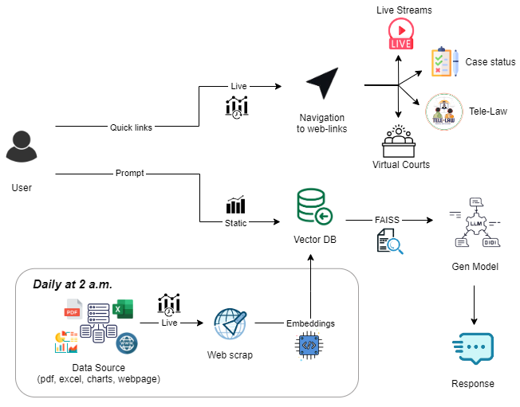

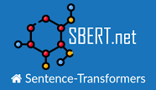













TECHNICAL APPROACH
AI ELITES
Workflow
Tech stacks
Model Development:
Web Technologies:
Deployment:

Slide 5




FEASIBILITY AND VIABILITY
AI ELITES
The chatbot automatically corrects mistakes in the prompt and provides relevant information seamlessly.
Efficient vector search with FAISS makes it feasible to quickly process and retrieve relevant information from large judicial data sets in real time.
Interactive features like live streaming of court cases and enhance the system's usefulness.
The AI Chatbot maintains freshness of data, ensuring that information is always up-to-date and accurate
Error Correction
Instant Info
Live streaming
Data freshness

Slide 6
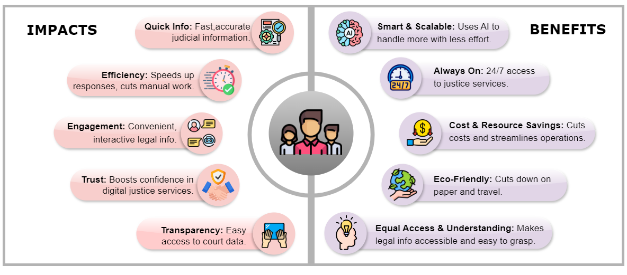
IMPACT AND BENEFITS
AI ELITES

Slide 7
RESEARCH AND REFERENCES
AI ELITES
DoJ: https://doj.gov.in/
DoJ Dashboard: https://dashboard.doj.gov.in/
e-Courts: https://services.ecourts.gov.in/ecourtindia_v6/
Supreme Court & High Court Websites
RAG: https://research.ibm.com/blog/retrieval-augmented-generation-RAG
Langchain: https://www.langchain.com/
FAISS: https://python.langchain.com/v0.2/docs/integrations/vectorstores/faiss/
Text Gen. Bot: https://huggingface.co/models?pipeline_tag=text-generation
Beautifulsoup: https://www.crummy.com/software/BeautifulSoup/bs4/doc/
Model: https://colab.research.google.com/drive/1wcm07m2cw8J4C_HyfodnmNvoSsKC_jYR#scrollTo=wqj5IUCqH2YZ

